Slide 1

AB-Vision-Trader: RL-Based Stock Trading Using Deep Q-Learning (DQN)
An Adaptive, Full-Stack Reinforcement Learning Trading Framework
Team: Aryan, Ayush, Ayushmaan, Bhavishya

Slide 2
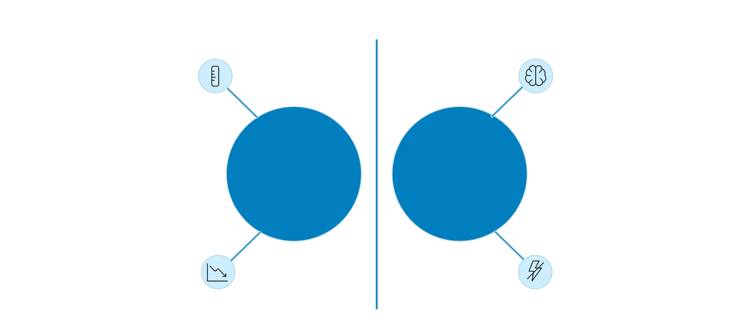


Problem & Motivation
The Challenge
Traditional trading approaches, such as technical analysis, fundamental analysis, and even many forms of algorithmic trading, often struggle to maintain profitability when market conditions shift dramatically. Technical indicators and chart patterns, which form the bedrock of technical analysis, are derived from historical data and can become unreliable during market regime changes (e.g., from bull to bear, or from low to high volatility). Fundamental analysis, while providing long-term value insights, can be slow to react to sudden shifts in investor sentiment or macroeconomic factors. Algorithmic strategies, typically built on predefined rules, lack the inherent adaptability to learn from new market dynamics, leading to significant drawdowns or missed opportunities during unprecedented events.
Static rules
Adaptive learning
Traditional Trading
Reinforcement Learning
Lagging indicators
Real-time decisions

Slide 3
Objectives
Complete RL Pipeline
DQN Implementation
Custom Environment
Build a complete RL trading pipeline
Implement DQN for multi-stock trading
Design custom OpenAI-style trading environment
Real Data Evaluation
Full-Stack Integration
Evaluate on 5 years of real OHLCV data
Integrate full-stack frontend + backend

Slide 4
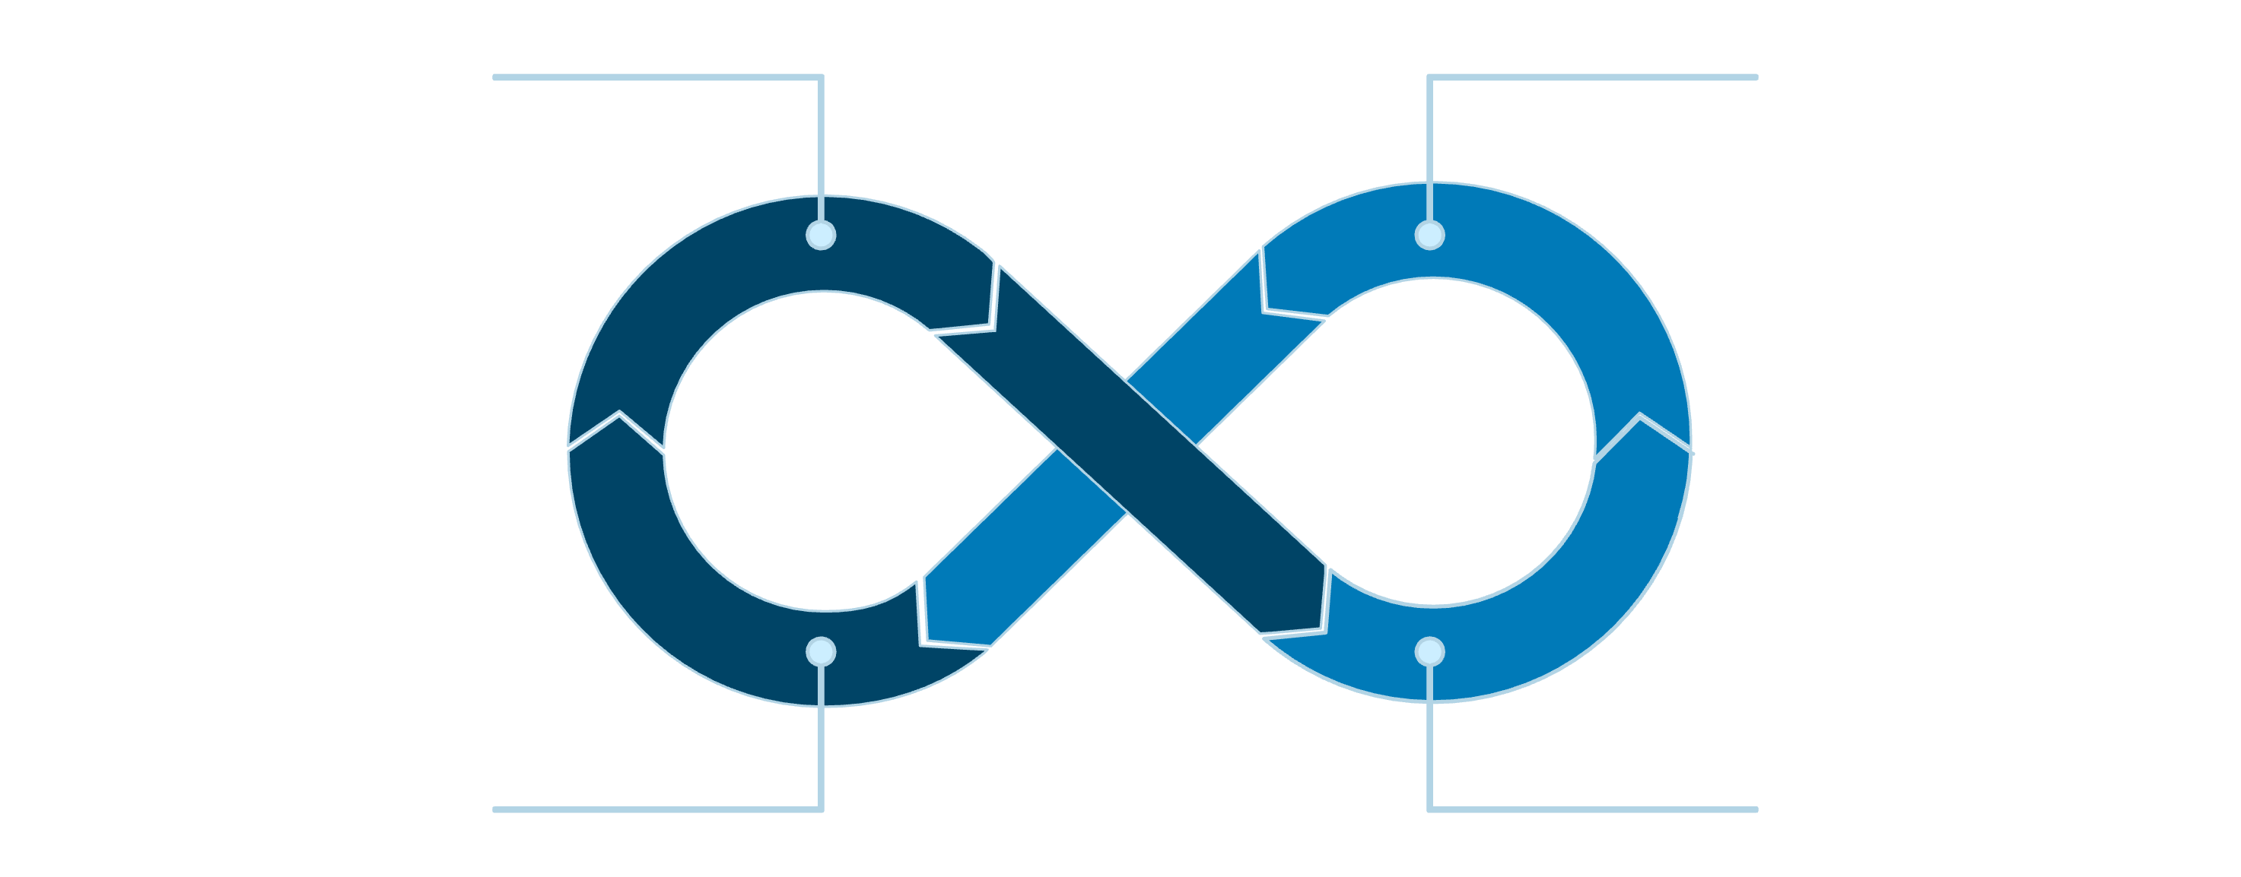
Reinforcement Learning Overview
State: Observe Market
Action: Buy / Hold / Sell
Reward: Portfolio Change
Next State: New Market
Goal
Why RL?
Perfect Fit
Maximize cumulative reward
Dynamic, sequential, uncertain
RL suits markets perfectly

Slide 5
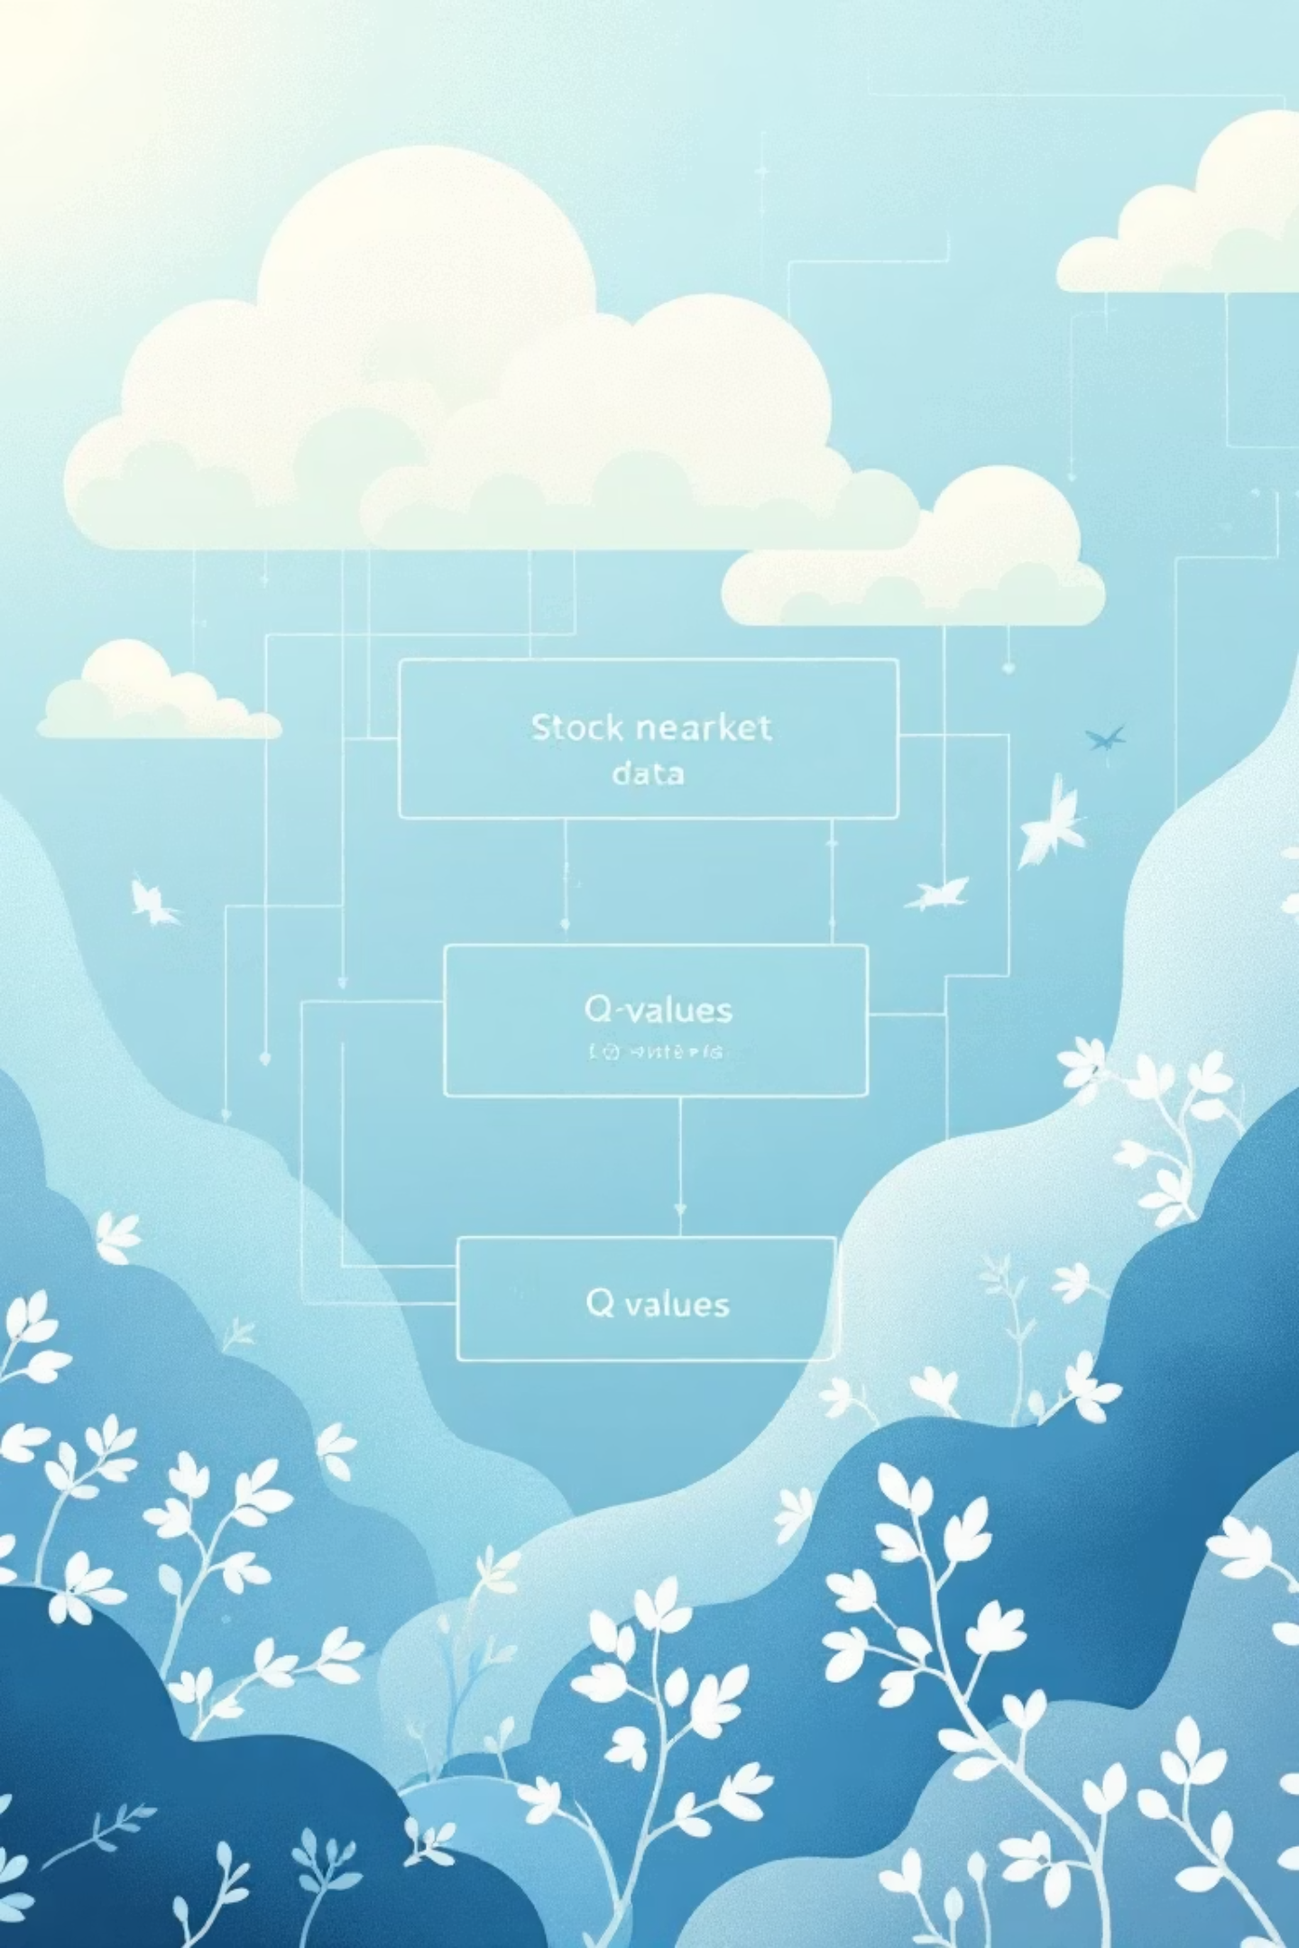
Why DQN?
1
Q-Value Approximation
Q-value approximation using neural networks
2
Replay Buffer
Replay buffer → stable learning
3
Target Network
Target network → reduces oscillation
4
ε-Greedy Strategy
ε-greedy → exploration vs exploitation

Slide 6


System Architecture
Frontend
API
React UI sends user requests to the API.
Express routes requests to the Python backend.
Python Backend
DQN Agent
Processes data and forwards to the DQN core.
Interacts with trading environment and reads dataset.
Key Features: Emphasize modularity & scalability

Slide 7
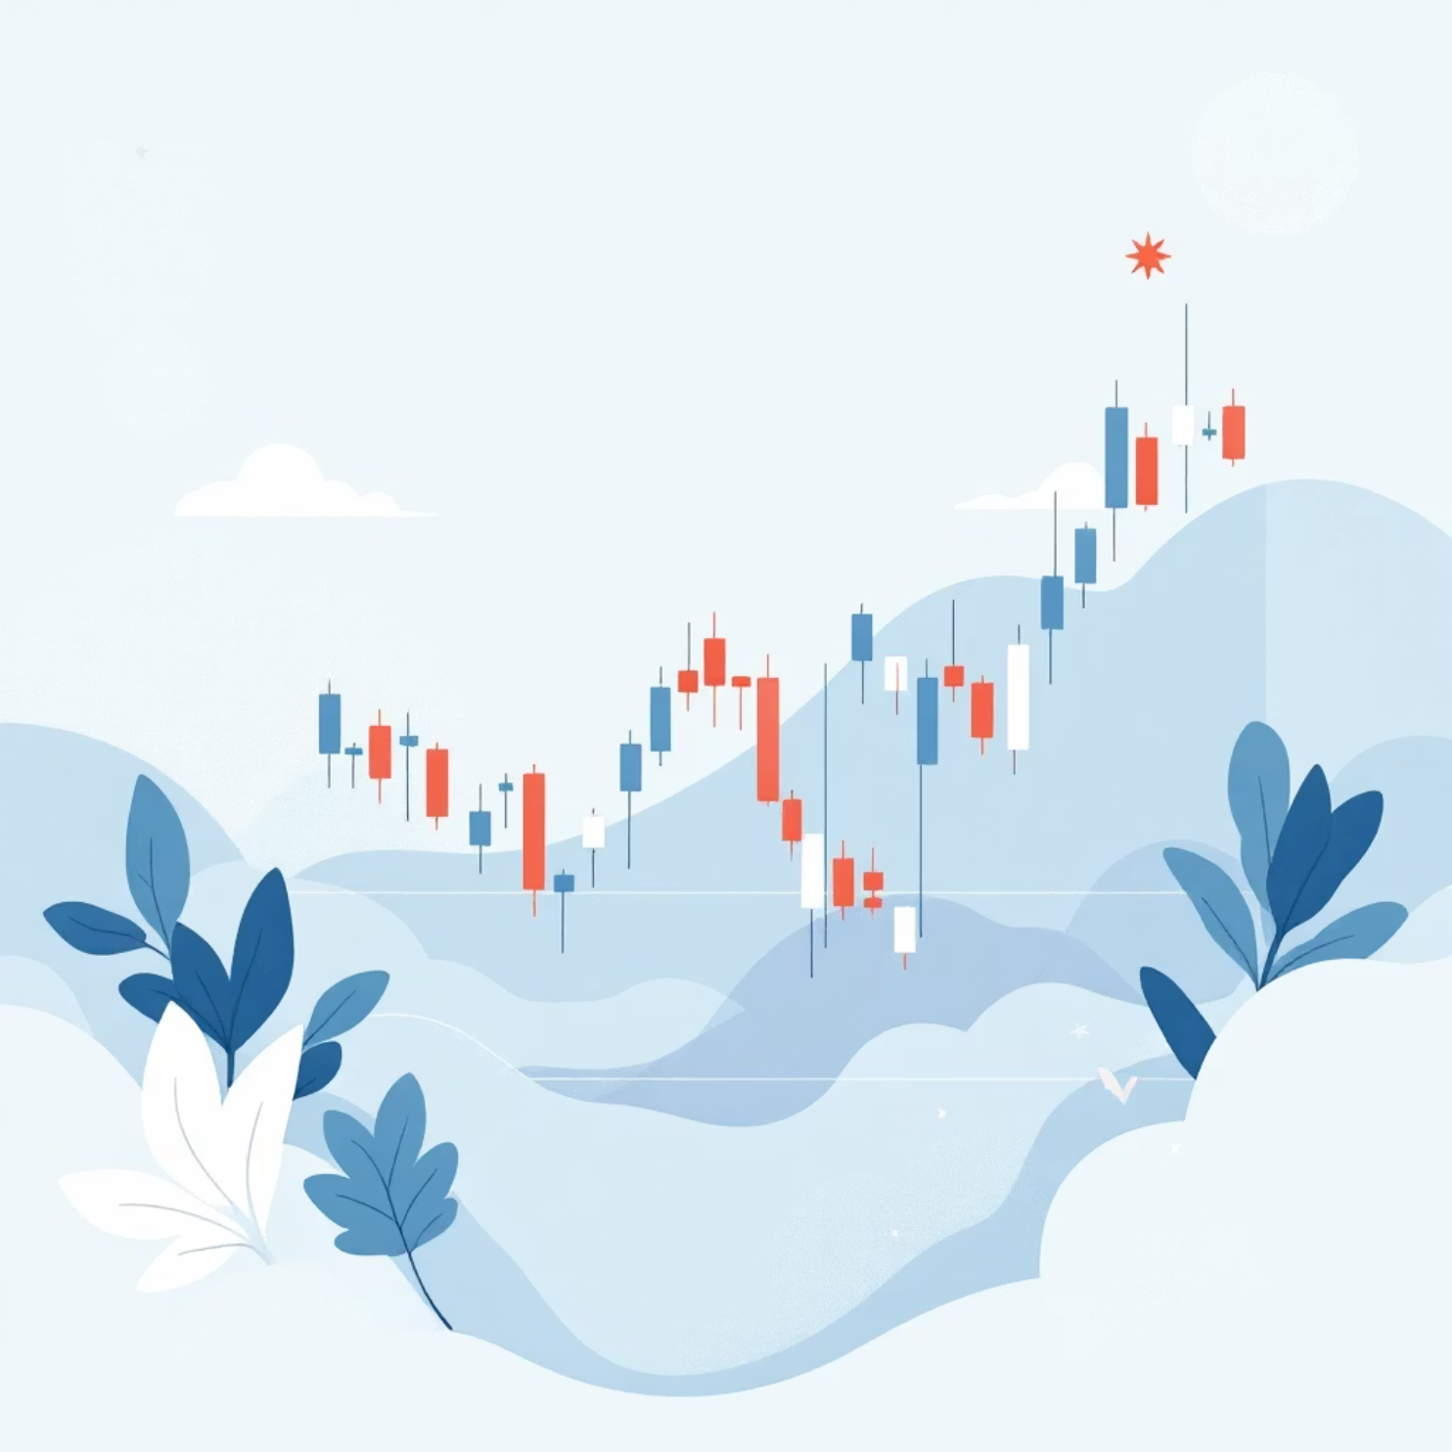
Dataset & Environment
Data Specifications
Data: 5 years OHLCV
Features: SMA(5,10), volatility, returns
Sliding window: 30-step sequences
Trading Mechanics
Actions: Hold / Buy / Sell
Reward: portfolio value change
Transaction cost: 0.1%

Slide 8
Model & Training
01
02
03
Network Architecture
Hyperparameters
Memory Buffer
MLP: 512 → 256 → 3 outputs
γ = 0.99, Adam optimizer
Replay buffer: 100k
04
05
Target Updates
Training Duration
Target network update: every 1,000 steps
Episodes: 150

Slide 9
Performance & Metrics
Show graphs & metrics:
+25.4%
1.45
58%
Return (AAPL)
Sharpe Ratio
Win Rate
Return, Sharpe Ratio, Max Drawdown, Win Rate
Example (AAPL):
+25.4% return
Sharpe 1.45
58% win rate
Results highlight adaptability vs naive strategies

Slide 10
Limitations & Future Scope
Current Limitations
Future Enhancements
No Double/Dueling DQN
Future: checkpointing, advanced DQN, leverage, shorting, visualization tools
No PER or slippage modeling
Limited reproducibility (no fixed seeds)
Thank You

